Slide 1
Control of Manufacturing Processes
  David Hardt
  October 30, 2013
Manufacturing

Slide 2
Topics for Today
Physical Origins of Variation
  Process Sensitivities
Statistical Models and Interpretation
  Process as a Random Variable(s)
  Diagnosis of Problems
Shewhart Charts
Process Capability
Next Steps: Optimization and Control

Slide 3
Process Objectives?
Rate
Quality
Cost
Flexibility

Slide 4
Process Control Objectives?
Rate
Quality
  Conformance to Specifications wrt
    Geometry
    Properties
Cost
Flexibility

Slide 5
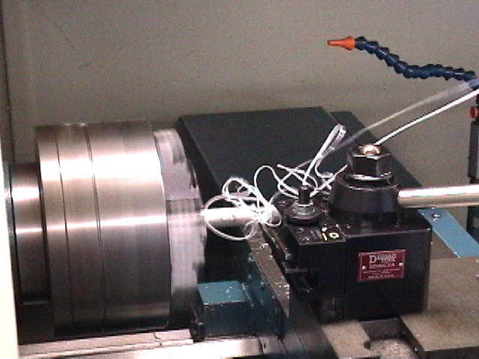
Lab Processes
CNC Turning
Critical Dimension:
Shaft Diameter

Slide 6
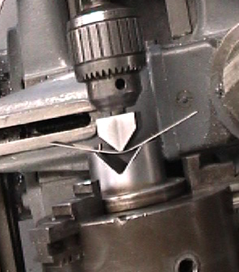
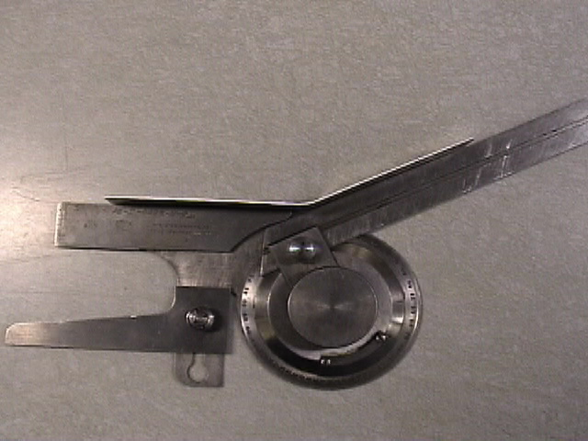
Lab Processes
Brake Bending
Critical Dimension:
Part Angle

Slide 7
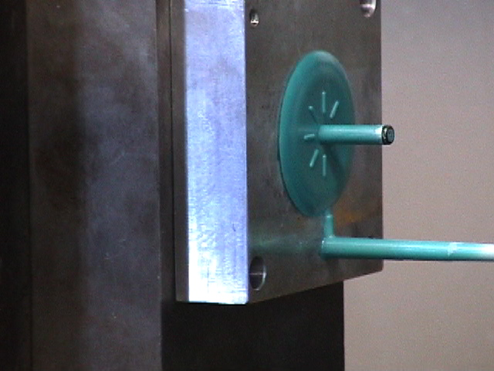
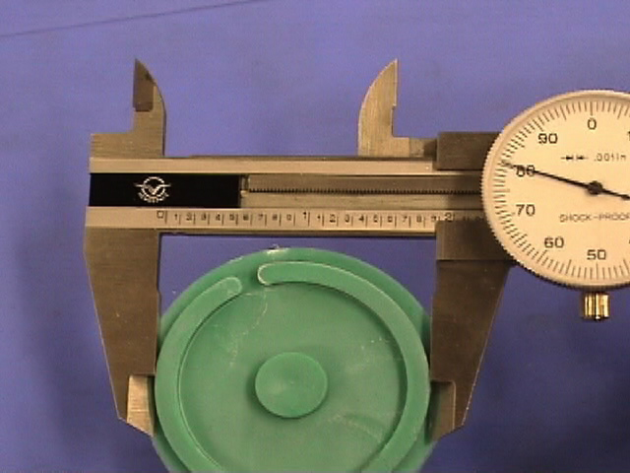
Lab Processes
Injection Molding
Critical Dimension:
?

Slide 8
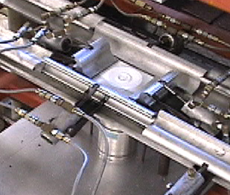
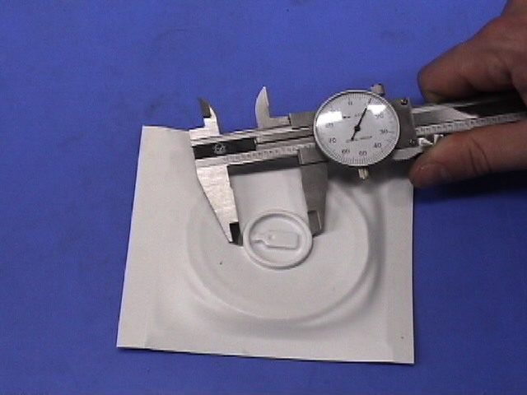
Lab Processes
Thermoforming
Critical Dimension:

Slide 9
Other Related Problems:
Cost, Rate and Flexibility:
100% inspection with high scrap rates
  low throughput
  high costs
100% Inspection with frequent rework
  low throughput
  high costs
High Variability at changeover
  Reluctance to changeover
  low flexibility

Slide 10
Manufacturing Processes
How are they defined?
How to they do their thing?
How can they be categorized?
Why don’t they always get it right?

Slide 11
Origins of Variation

Slide 12
The Process Components
Operator
Workpiece Material
Part
Equipment
Etch bath
Injection Molder
Lathe
Draw Press
...
Coated Silicon
Plastic Pellets
Bar stock
Sheet Metal
...
Semiconductor
Connector Body
Shaft
Hood
...

Slide 13
What Causes Variation in the Process Output?
Material Variations
  Properties, Initial Geometry
Equipment Variations
  Non-repeatable, long term wear, deflections
Operator Variations
  Inconsistent control, excessive “tweaking”
“Environment” Variations
  Temperature and Handling inconsistencies

Slide 14
Can We Rank These?
Likelihood of Variation?
Frequency of Variation?
Magnitude of Variation?
Sensitivity to Variation?

Slide 15
Can We Rank These?
Equipment
  Fixed “Iron”
  Can be Automated (Controlled) to Keep Energy States as Desired
Material
  “Flows” Through the Process
    Constantly Changing
  Energy Transfer from Equipment Variable

Slide 16
Process Control Hierarchy
Identify and Reduce Disturbances
  Good Housekeeping (Ops Management)
  Standard Operations (SOP’s)
  Statistical Analysis and Identification of Sources
  Feedback Control of Machines
  Reduce Sensitivity (Process Optimization or Robustness)
  Measure Sensitivities via Designed Experiments
  Adjust “free” parameters to minimize
Measure output and manipulate inputs
  Feedback control of Output(s)

Slide 17
Why not Always
“Process Output Control”?
Lack of Measurements
  Shape not accessible
Lack of Spatial Resolution
  Complex shape, simple control u
Cost/Benefit vs. Other Methods
Sufficiency of Equipment Control
  e.g. numerical control

Slide 18
Modeling Variation

Slide 19
Applying Statistics to Manufacturing:
The Shewhart Approach (circa 1925)*
All Physical Processes Have a Degree of Natural Randomness
A Manufacturing Process is a Random Process if all “Assignable Causes” (identifiable disturbances) are eliminated
A Process is “In Statistical Control” if only “Common Causes” (Purely Random Effects) are present.
W.A. Shewhart, “The Applications of Statistics as an Aid in Maintaining Quality of a Manufactured Product”, Journal of the American Statistical Association, 20, No.. 152, Dec. 1925.

Slide 20
Shewhart Applied to Manufacturing
Measure and Plot the Process Output
Look for Any Sign of Non-Random (Deterministic) Behavior
  Out of Statistical Control
Identify the Cause of that Behavior and Reduce or Eliminate it
Verify That the Process is NowPurely Random
  In Statistical Control

Slide 21
Statistical Models for Manufacturing

Slide 22
Consdier: Turning Process

Slide 23
Observations from Experiments
Randomness + Deterministic Changes
random or unknown
Da

Slide 24
Brake Bending of Sheet
Output:
Angle

Slide 25
Bending Process
Springback

Slide 26
Observations from Bending Process
Clear Input-Output Effects (Deterministic)
Also Randomness as well
Angle changes with depth
DY -> Du

Slide 27
Observations from Injection Molding

Slide 28
Consider:
No Effective Changes (∂Y/∂u= 0)
Injection Molding Entire Run

Slide 29
Injection Molding (S’2003)

Slide 30
How To Model to Distinguish these Effects?
Inputs
A Random Process + A Deterministic Process

Slide 31
Random Processes
Consider the Output-only, “Black Box” view of the Run Chart
How do We Characterize The Process?
  Using Y(t) only
WHY do we Characterize the Process
  Using Y(t) only?
Y(t)
Process

Slide 32
How to Describe Randomness?
Look at a Frequency Histogram of the Data
Estimates likelihood of certain ranges occurring:
      Pr(y₁ < Y <y₂)
      “Probability that a random variable Y falls between the limits y₁ and y₂”

Slide 33
Analysis of Histograms
Is there a consistent pattern?
Is an underlying “parent” distribution suggested?

Slide 34
Process Outputs as a Random Variable
The Histogram suggests a pdf
  Parent or underlying behavior “sampled” by the process
Standard Forms (There are many)
  e.g. The Uniform and Normal pdf’s

Slide 35
Histogram for CNC Turning

Slide 36
Histogram for Bending
(MIT 2002 data)
0.3 in depth only

Slide 37
Histogram for Bending
(MIT 2002 data)
0.6 in depth only

Slide 38
Conclusion?
When there are no input effect (no Δu or ∂Y/∂u) a consistent histogram pattern can emerge
How do we use knowledge of this pattern?
  Predict behavior
  Set limits on “normal” behavior
Define analytical probability density functions

Slide 39
Underlying or “Parent” Probability
A model of the “true”, continuous behavior of the random process
Can be thought of as a continuous random variable obeying a set of rules (the probability function)
We can only glimpse into these rules by sampling the random variable (i.e. the process output)
Underlying process can have
  Continuous Values (e.g. geometry)
  Discrete Values (e.g. defect occurrence)

Slide 40
The Uniform Distribution
p(x)
1/r
r
x₂
x
x₁

Slide 41
Standard Normal Distribution
z

Slide 42
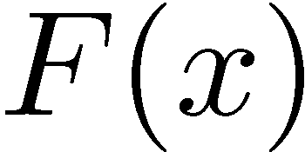
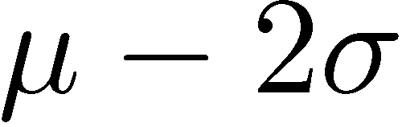


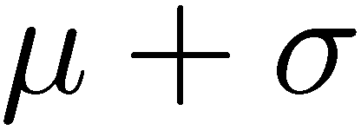
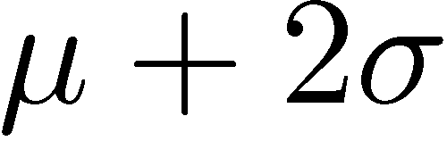

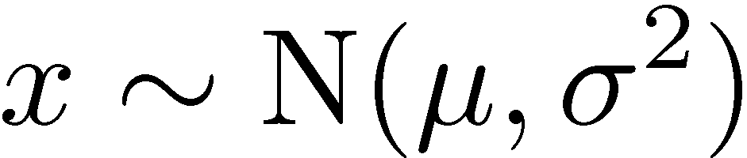
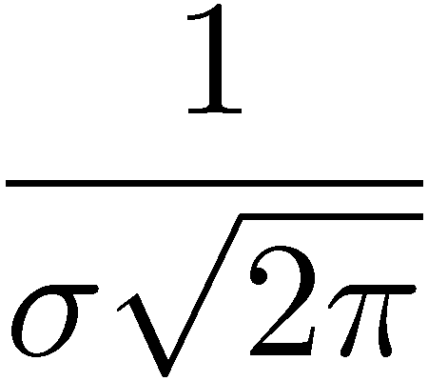
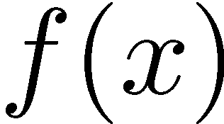
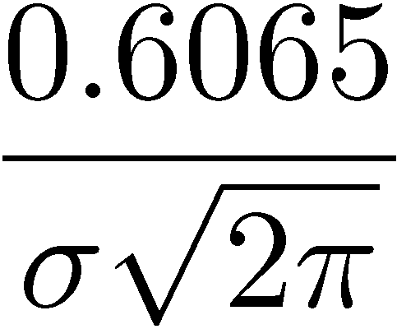
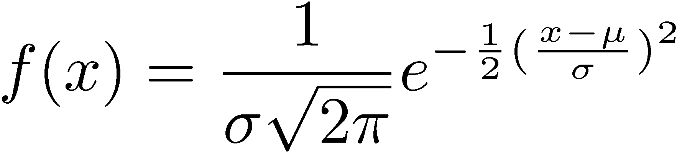
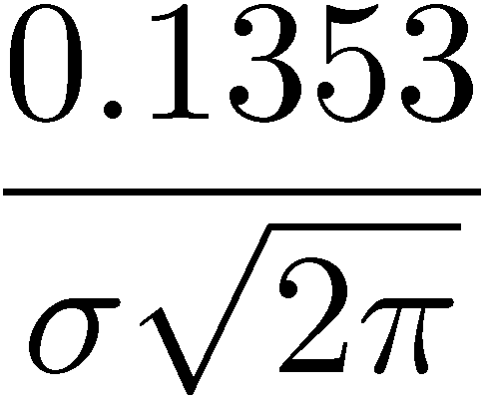
Continuous Distribution: Normal or Gaussian
cdf
1
0.84
0.5
0.16
0
pdf

Slide 43
Properties of the Normal pdf
Symmetric about mean
Only two parameters:
  μ and σ²
Superposition Applies:
  sum of normal random variables has a normal distribution

Slide 44
Interpretation of the PDF:
Confidence Intervals
Probability that |x| >m+3s = 3/1000
68%
95%
99.7%

Slide 45
Model Calibration
For the Normal PDF, we need two parameters: μ and σ
We have to estimate μ and σ using sample statistic based on samples of the output (i.e. measurements)

Slide 46
Sample Statistics

Slide 47
Conclusions
All Physical Processes Have a Degree of Natural Randomness
We can Model this Behavior using Probability Distribution Functions
We can Calibrate and Evaluate the Quality of this Model from Measurement Data using appropriate Sample Statistics

Slide 48
In-Control (Almost)

Slide 49
Not In-Control

Slide 50
“Not In-Control”

Slide 51
“In-Control”
...
i+2
Time
The Parent Distribution Does Not Change with Time
i+1
i

Slide 52
“Not In-Control”
...
i+2
Time
The Parent Distribution Changes with Time
i+1
i

Slide 53
“Not In-Control”
Variance Increase
...
Mean Shift + Variance Change
Time
Mean Shift

Slide 54
Applying in Real-Time:
Xbar and S Charts
Shewhart:
  Plot sequential average of process
    Xbar chart
    Distribution?
  Plot sequential sample standard deviation
    S chart

Slide 55
Data Sampling and Sequential Averages
Given a sequence of process outputs x_{i}:
j j+1 j+2 ...
sample interval DT
A sequential sample of size n
Take at intervals DT
Sample index j
n measurements
at sample j

Slide 56
Data Sampling
j j+1 j+2 ...
sample interval DT
n measurements
at sample j
sample j mean
sample j variance

Slide 57
Plot of xbar and S
Random Data n=5
xbar
S

Slide 58
Overall Statistics
Grand Mean
Grand Standard Deviation

Slide 59
Setting Chart Limits
Expected Ranges
Confidence Intervals
  Intervals of + n Standard Deviations
  Most Typical is + 3σ

Slide 60
Chart Limits - Xbar
(S_{j} is a biased estimator)
If we knew σ_{x} then:
But Since we Estimate the Sample Standard Deviation, then

Slide 61
Chart Limits xbar chart
The estimate of True Sample Mean Variance (variance of the mean) is biased
To remove this bias for the xbar ± 3s limits we use:
For the example n=5

Slide 62
Chart Limits S
The variance of the estimate of S can be shown to be:
So we get the chart limits:

Slide 63
Example xbar
UCL
Grand
Mean
LCL

Slide 64
Example S
UCL
Grand S
LCL

Slide 65
Detecting Problems from Running Data
Appearance of data
  Confidence Intervals
  Frequency of extremes
  Trends

Slide 66
Western Electric Rules
Points outside limits
2-3 consecutive points outside 2 sigma
Four of five consecutive points beyond 1 sigma
Run of 8 consecutive points on one side of center

Slide 67
Test for “Out of Control”
Extreme Points
  Outside ±3σ
Improbable Points
  2 of 3 >±2σ
  4 of 5 >± 1σ
  All points inside ±1σ

Slide 68
Tests for “Out of Control”
Consistently above or below centerline
  Runs of 8 or more
Linear Trends
  6 or more points in consistent direction
Bi-Modal Data
  8 successive points outside ±1σ

Slide 69
Applying Shewhart Charting
Find a run of 25-50 points that are “in-control”
Compute chart centerlines and limits
Begin Plotting subsequent xbar_{j} and S_{j}
Apply rules, or look for trends, improbable events or extremes.
If these occur, process is “out of control”

Slide 70
Real-Time
Historical Data
The “Future”

Slide 71
Out of Control
Data is not Stationary
  (μ or σ are not constant)
Process Output is being “caused” by a disturbance (common cause)
This disturbance can be identified and eliminated
  Trends indicate certain types
  Correlation with know events
    shift changes
    material changes

Slide 72
“In-Control”
...
i+2
Time
What will chart look like?
i+1
i

Slide 73
“Not In-Control”
...
i+2
Time
What will chart look like?
i+1
i

Slide 74
Another Use of the
Statistical Process Model:
The Manufacturing -Design Interface
We now have an empirical model of the process
How “good” is the process?
Is it capable of producing what we need?
-3s
m
+3s

Slide 75
Process Capability
Assume Process is In-control
Described fully by xbar and s
Compare to Design Specifications
  Tolerances
  Quality Loss

Slide 76
Design Specifications
Tolerances: Upper and Lower Limits
Characteristic
Dimension
Lower Specification Limit
LSL
Target
x*
Upper Specification Limit
USL

Slide 77
Design Specifications
Quality Loss: Penalty for Any Deviation from Target
QLF = L*(x-x*)²
How to Calibrate?
x*=target

Slide 78
Use of Tolerances:
Process Capability
Define Process using a Normal Distribution
Superimpose x*, LSL and USL
Evaluate Expected Performance
LSL
x*
USL
-3s
m
+3s

Slide 79
Process Capability
Definitions
Compares ranges only
No effect of a mean shift:

Slide 80
Process Capability: C_{pk}
= Minimum of the normalized deviation from the mean
Compares effect of offsets

Slide 81
Cp = 1; Cpk = 1

Slide 82
Cp = 1; Cpk = 0

Slide 83
Cp = 2; Cpk = 1

Slide 84
Cp = 2; Cpk = 2

Slide 85
Effect of Changes
In Design Specs
In Process Mean
In Process Variance
What are good values of Cp and Cpk?

Slide 86
Cpk Table
Cpk | z | P<LS or
 |  | P>USL
1 | 3 | 1E-03
1.33 | 5 | 3E-07
1.67 | 4 | 3E-05
2 | 6 | 1E-09

Slide 87
The “6 Sigma” problem
P(x > 6s) = 18.8x10⁻¹⁰
C_{p}=2
C_{pk}=2
LSL
-3s*
+3s*
USL
6s

Slide 88
The 6 σ problem: Mean Shifts
C_{p}=2
C_{pk}=4/3
P(x>4s) = 31.6x10⁻⁶
Even with a mean shift of 2s
we have only 32 ppm out of spec
LSL
USL
4s

Slide 89
Capability from the Quality Loss Function
QLF = L(x) =k*(x-x*)²
x*
Given L(x) and p(x) what is E{L(x)}?

Slide 90
Expected Quality Loss
Penalizes Variation
Penalizes Deviation

Slide 91
Process Capability
The reality (the process statistics)
The requirements (the design specs)
Cp - a measure of variance vs. tolerance
Cpk a measure of variance from target
Expected Loss- An overall measure of goodness

Slide 92
Process Control Hierarchy
Identify and Reduce Causal Disturbances
  Good Housekeeping
  Standard Operations (SOP’s)
  Feedback Control of Machines
    Eliminate Equipment Variations
  Statistical Analysis and Identification of Sources (SPC)
    Eliminate Assignable Causes

Slide 93
Process Control Hierarchy
NEXT: Reduce Sensitivity to Disturbance
  Measure Sensitivities via Designed Experiments (DOE)
  Adjust “free” parameters to minimize variations

Slide 94
Example: Bending Sensitivity to Yield Stress
  Simple Example: Die Width for Air Bending (An adjustable equipment property):
  Wide Die:
    Low force,
    high spring back,
    high sensitivity to variations in yield stress
  Narrow Die:
    High force,
    Higher material stress,
    Lower spring back,
    Lower sensitivity to variations in yield stress,

Slide 95
Final Step :“Output Control”
Desired
Output
C
Equipment
Material
Geometry &
Properties
“critical dimensions”
Examples:
Web Thickness in Milling
Sheet Thickness in Rolling
Sheet Angle in Bending

Slide 96
Implementing Product Feedback Control
Continuous In-Process Measurements
  Regulate Process States In-Process
Sampling and Monitoring (SPC)
  Measure After-Process and Diagnose
Part to Part Sampling and Control
  Cycle to Cycle Control: Measure After each Cycle and Improve Process Capability

Slide 97
Conclusions: Single Variable Case
Cycle to Cycle Control
  Obeys Root Locus Prediction wrt Dynamics
  Amplifies White Noise Disturbance Attenuates Colored Noise Disturbance
  Can Reduce Mean Error (Zero if I-control)
  Can Reduce “Open Loop” Expected Loss
Lower Spec
T
Upper Spec

Slide 98
Feedback Control Objectives
Steady-State Error from Target
Disturbance Rejection
Target

Slide 99
It Works!:
Bending Step Disturbance
Effect of Material Change
  Switch to a Stiffer Material – more springback.

Slide 100
Manufacturing Objective
Process
Process Output
Method?:
  SPC
  Optimization
  Output Feedback
Design Goal
LSL T USL

Slide 101
Conclusions
Shewhart Charts
  Application of Statistics to Production
  Plot Evolution of Sample Statistics and S
  Look for Deviations from Model
Process Capability
  A measure of the process to meet a requirement
  Includes variance and bias
  Gets design and manufacturing talking
If That’s Not Good Enough
  DOE/Optimization
  Feedback Control
  …

